Slide 1
DIGITAL COMMUNICATION
UNIT-1
Introduction:
Basic block diagram of digital and data communication systems. Their comparison with analog communication systems.

Slide 2
Introduction to Digital Communication
The communication that occurs in our day-to-day life is in the form of signals. These signals, such as sound signals, generally, are analog in nature. When the communication needs to be established over a distance, then the analog signals are sent through wire, using different techniques for effective transmission.

Slide 3
The Necessity of Digitization
The conventional methods of communication used analog signals for long distance communications, which suffer from many losses such as distortion, interference, and other losses including security breach.
In order to overcome these problems, the signals are digitized using different techniques. The digitized signals allow the communication to be more clear and accurate without losses.
The following figure indicates the difference between analog and digital signals. The digital signals consist of 1s and 0s which indicate High and Low values respectively.

Slide 4
Representation of Signals

Slide 5
Comparison of Digital Communication With Analog Communication
As the signals are digitized, there are many advantages of digital communication over analog communication, such as −
The effect of distortion, noise, and interference is much less in digital signals as they are less affected.
Digital circuits are more reliable.
Digital circuits are easy to design and cheaper than analog circuits.
The hardware implementation in digital circuits, is more flexible than analog.
The occurrence of cross-talk is very rare in digital communication.

Slide 6
The signal is un-altered as the pulse needs a high disturbance to alter its properties, which is very difficult.
Signal processing functions such as encryption and compression are employed in digital circuits to maintain the secrecy of the information.
The probability of error occurrence is reduced by employing error detecting and error correcting codes.
Spread spectrum technique is used to avoid signal jamming.
Combining digital signals using Time Division Multiplexing TDM TDM is easier than combining analog signals using Frequency Division Multiplexing FDM FDM.

Slide 7
The configuring process of digital signals is easier than analog signals.
Digital signals can be saved and retrieved more conveniently than analog signals.
Many of the digital circuits have almost common encoding techniques and hence similar devices can be used for a number of purposes.
The capacity of the channel is effectively utilized by digital signals.

Slide 8
Block Diagram of Digital Communication
The elements which form a digital communication system is represented by the following block diagram for the ease of understanding.

Slide 9
Following are the sections of the digital communication system:-
Source:-
The source can be an analog signal. Example: A Sound signal
Input Transducer:-
This is a transducer which takes a physical input and converts it to an electrical signal (Example: microphone). This block also consists of an analog to digital converter where a digital signal is needed for further processes.
A digital signal is generally represented by a binary sequence.

Slide 10
Digital Modulator
The signal to be transmitted is modulated here by a carrier. The signal is also converted to analog from the digital sequence, in order to make it travel through the channel or medium.
Channel
The channel or a medium, allows the analog signal to transmit from the transmitter end to the receiver end.

Slide 11
Source Encoder:-
The source encoder compresses the data into minimum number of bits. This process helps in effective utilization of the bandwidth. It removes the redundant bits unnecessaryexcessbits,i.e.,zeroesunnecessaryexcessbits,i.e.,zeroes.
Channel Encoder:-
The channel encoder, does the coding for error correction. During the transmission of the signal, due to the noise in the channel, the signal may get altered and hence to avoid this, the channel encoder adds some redundant bits to the transmitted data. These are the error correcting bits.

Slide 12
Digital Demodulator
This is the first step at the receiver end. The received signal is demodulated as well as converted again from analog to digital. The signal gets reconstructed here.
Channel Decoder
The channel decoder, after detecting the sequence, does some error corrections. The distortions which might occur during the transmission, are corrected by adding some redundant bits. This addition of bits helps in the complete recovery of the original signal.

Slide 13
Source Decoder
The resultant signal is once again digitized by sampling and quantizing so that the pure digital output is obtained without the loss of information. The source decoder recreates the source output.
Output Transducer
This is the last block which converts the signal into the original physical form, which was at the input of the transmitter. It converts the electrical signal into physical output (Example: loud speaker).

Slide 14
Output Signal
This is the output which is produced after the whole process. Example − The sound signal received.
This unit has dealt with the introduction, the digitization of signals, the advantages and the elements of digital communications. In the coming chapters, we will learn about the concepts of Sampling Theorem and Quantization, etc.

Slide 15
Unit-2 Sampling theorem and its basic concept.
Use of Sampling Theorem:
-Introduction to PAM, PPM, PWM
-Quantization and error of Quantization
-PCM, DPCM, their advantage and disadvantage
-DELTA and ADAPTIVE DELTA Modulation concept of COMPANDING
- Frequency hopping spread spectrum technique

Slide 16
Sampling Theorem Defination
The sampling theorem can be defined as the conversion of an analog signal into a discrete form by taking the sampling frequency as twice the input analog signal frequency. Input signal frequency denoted by Fm and sampling signal frequency denoted by Fs.
The output sample signal is represented by the samples. These samples are maintained with a gap, these gaps are termed as sample period or sampling interval (Ts). And the reciprocal of the sampling period is known as “sampling frequency” or “sampling rate”. The number of samples is represented in the sampled signal is indicated by the sampling rate.
Sampling frequency Fs=1/Ts

Slide 17
Sampling Theorem Statement
Sampling theorem states that “continues form of a time-variant signal can be represented in the discrete form of a signal with help of samples and the sampled (discrete) signal can be recovered to original form when the sampling signal frequency Fs having the greater frequency value than or equal to the input signal frequency Fm.
Fs ≥ 2Fm
If the sampling frequency (Fs) equals twice the input signal frequency (Fm), then such a condition is called the Nyquist Criteria for sampling. When sampling frequency equals twice the input signal frequency is known as “Nyquist rate”.

Slide 18
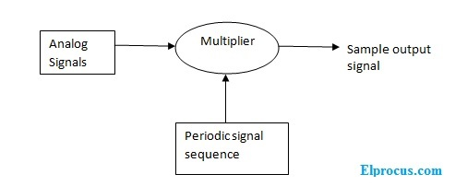
Sampling Output Block Diagram

Slide 19
Sampling Output Waveforms
The sampling process requires two input signals. The first input signal is an analog signal and another input is sampling pulse or equidistance pulse train signal. And the output which is then sampled signal comes from the multiplier block. The sampling process output waveforms are shown below.

Slide 20
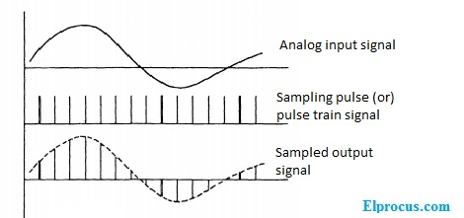
Sampling Output Waveforms

Slide 21
Analog Pulse Modulation
After the continuous wave modulation, the next division is Pulse modulation. Pulse modulation is further divided into analog and digital modulation. The analog modulation techniques are mainly classified into Pulse Amplitude Modulation, Pulse Duration Modulation/Pulse Width Modulation, and Pulse Position Modulation

Slide 22
Pulse Amplitude Modulation
Pulse Amplitude Modulation (PAM) is an analog modulating scheme in which the amplitude of the pulse carrier varies proportional to the instantaneous amplitude of the message signal.
The pulse amplitude modulated signal, will follow the amplitude of the original signal, as the signal traces out the path of the whole wave. In natural PAM, a signal sampled at the Nyquist rate is reconstructed, by passing it through an efficient Low Pass Frequency (LPF) with exact cutoff frequency

Slide 23
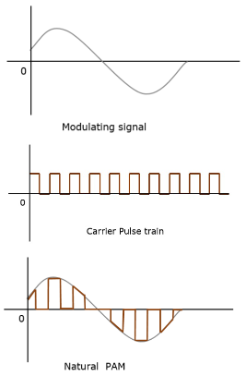
The following figures explain the Pulse Amplitude Modulation

Slide 24
Pulse Width Modulation
Pulse Width Modulation (PWM) or Pulse Duration Modulation (PDM) or Pulse Time Modulation (PTM) is an analog modulating scheme in which the duration or width or time of the pulse carrier varies proportional to the instantaneous amplitude of the message signal.
The width of the pulse varies in this method, but the amplitude of the signal remains constant. Amplitude limiters are used to make the amplitude of the signal constant. These circuits clip off the amplitude, to a desired level and hence the noise is limited.

Slide 25
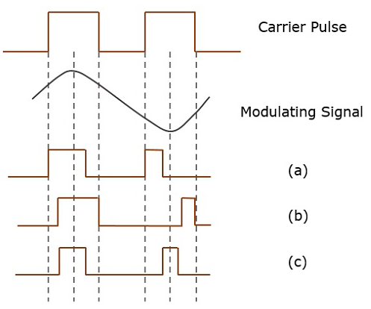
The following figures explain the types of Pulse Width Modulations.

Slide 26
Pulse Position Modulation
Pulse Position Modulation (PPM) is an analog modulating scheme in which the amplitude and width of the pulses are kept constant, while the position of each pulse, with reference to the position of a reference pulse varies according to the instantaneous sampled value of the message signal.
The transmitter has to send synchronizing pulses (or simply sync pulses) to keep the transmitter and receiver in synchronism. These sync pulses help maintain the position of the pulses.

Slide 27
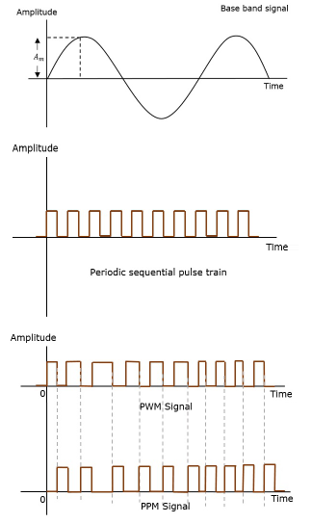
The following figures explain the Pulse Position Modulation.

Slide 28
Comparison between PAM, PWM, and PPM

Slide 29
Quantization
The digitization of analog signals involves the rounding off of the values which are approximately equal to the analog values. The method of sampling chooses a few points on the analog signal and then these points are joined to round off the value to a near stabilized value. Such a process is called as Quantization.

Slide 30
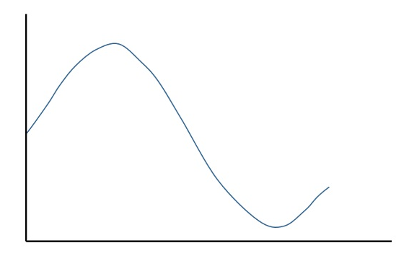
Quantizing an Analog Signal
The analog-to-digital converters perform this type of function to create a series of digital values out of the given analog signal. The following figure represents an analog signal. This signal to get converted into digital, has to undergo sampling and quantizing.

Slide 31
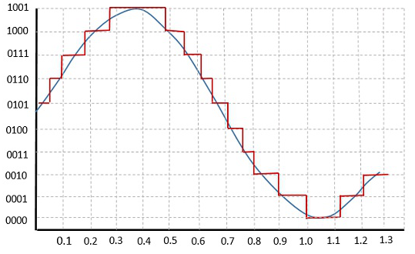
The quantizing of an analog signal is done by discretizing the signal with a number of quantization levels. Quantization is representing the sampled values of the amplitude by a finite set of levels, which means converting a continuous-amplitude sample into a discrete-time signal.
The following figure shows how an analog signal gets quantized. The blue line represents analog signal while the brown one represents the quantized signal.

Slide 32
Contd…
Both sampling and quantization result in the loss of information. The quality of a Quantizer output depends upon the number of quantization levels used. The discrete amplitudes of the quantized output are called as representation levels or reconstruction levels. The spacing between the two adjacent representation levels is called a quantum or step-size.

Slide 33
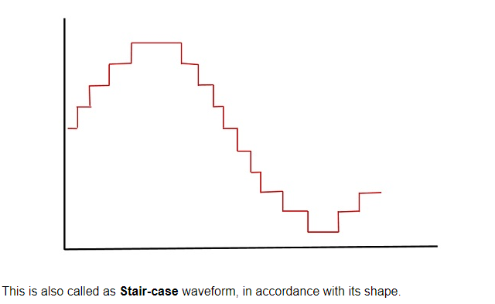
Contd…
The following figure shows the resultant quantized signal which is the digital form for the given analog signal.

Slide 34
Types of Quantization
There are two types of Quantization:
Uniform Quantization
Non-uniform Quantization
The type of quantization in which the quantization levels are uniformly spaced is termed as a Uniform Quantization.
The type of quantization in which the quantization levels are unequal and mostly the relation between them is logarithmic, is termed as a Non-uniform Quantization.

Slide 35
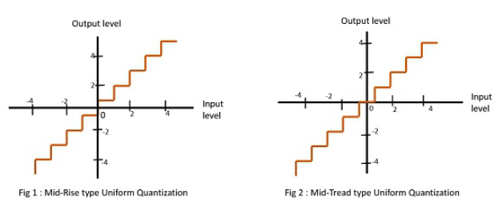
There are two types of uniform quantization. They are Mid-Rise type and Mid-Tread type. The following figures represent the two types of uniform quantization.

Slide 36
Contd…
Figure 1 shows the mid-rise type and figure 2 shows the mid-tread type of uniform quantization.
The Mid-Rise type is so called because the origin lies in the middle of a raising part of the stair-case like graph. The quantization levels in this type are even in number.
The Mid-tread type is so called because the origin lies in the middle of a tread of the stair-case like graph. The quantization levels in this type are odd in number.
Both the mid-rise and mid-tread type of uniform quantizers are symmetric about the origin.

Slide 37
Quantization Error
For any system, during its functioning, there is always a difference in the values of its input and output. The processing of the system results in an error, which is the difference of those values.
The difference between an input value and its quantized value is called a Quantization Error. A Quantizer is a logarithmic function that performs Quantization roundingoffthevalueroundingoffthevalue. An analog-to-digital converter (ADC) works as a quantizer.

Slide 38
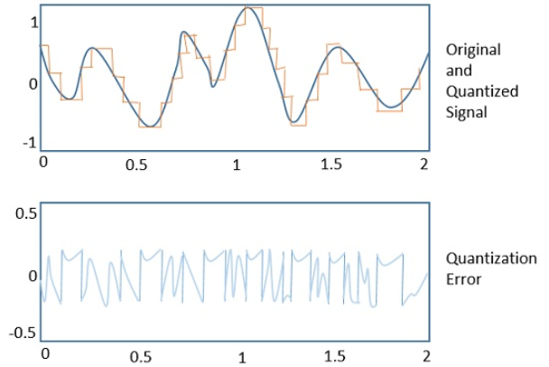
The following figure illustrates an example for a quantization error, indicating the difference between the original signal and the quantized signal.

Slide 39
Quantization Noise
It is a type of quantization error, which usually occurs in analog audio signal, while quantizing it to digital. For example, in music, the signals keep changing continuously, where a regularity is not found in errors. Such errors create a wideband noise called as Quantization Noise.

Slide 40
Pulse Code Modulation
A signal is pulse code modulated to convert its analog information into a binary sequence, i.e., 1s and 0s. The output of a PCM will resemble a binary sequence. The following figure shows an example of PCM output with respect to instantaneous values of a given sine wave.

Slide 41
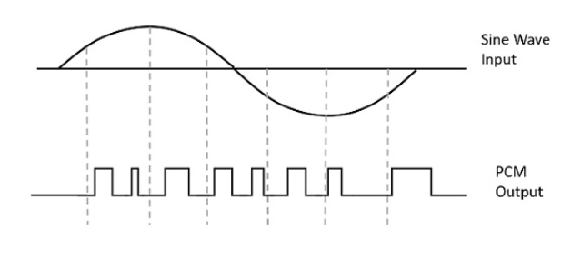
Waveform of PCM

Slide 42
Instead of a pulse train, PCM produces a series of numbers or digits, and hence this process is called as digital. Each one of these digits, though in binary code, represent the approximate amplitude of the signal sample at that instant.
In Pulse Code Modulation, the message signal is represented by a sequence of coded pulses. This message signal is achieved by representing the signal in discrete form in both time and amplitude.

Slide 43
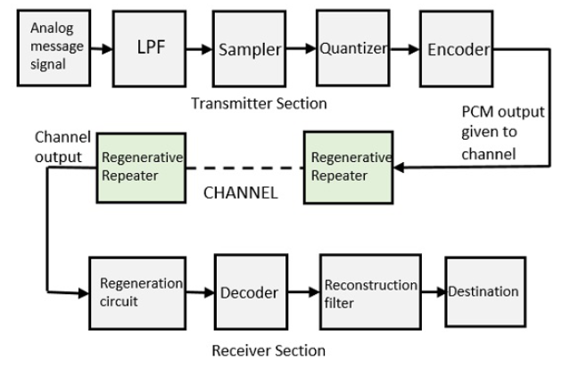
Basic Elements of PCM

Slide 44
Low Pass Filter
This filter eliminates the high frequency components present in the input analog signal which is greater than the highest frequency of the message signal, to avoid aliasing of the message signal.
Sampler
This is the technique which helps to collect the sample data at instantaneous values of message signal, so as to reconstruct the original signal. The sampling rate must be greater than twice the highest frequency component W of the message signal, in accordance with the sampling theorem.

Slide 45
Quantizer
Quantizing is a process of reducing the excessive bits and confining the data. The sampled output when given to Quantizer, reduces the redundant bits and compresses the value.
Encoder
The digitization of analog signal is done by the encoder. It designates each quantized level by a binary code. The sampling done here is the sample-and-hold process. These three sections LPF,Sampler,andQuantizerLPF,Sampler,andQuantizer will act as an analog to digital converter. Encoding minimizes the bandwidth used.

Slide 46
Regenerative Repeater
This section increases the signal strength. The output of the channel also has one regenerative repeater circuit, to compensate the signal loss and reconstruct the signal, and also to increase its strength.
Decoder
The decoder circuit decodes the pulse coded waveform to reproduce the original signal. This circuit acts as the demodulator.

Slide 47
Reconstruction Filter
After the digital-to-analog conversion is done by the regenerative circuit and the decoder, a low-pass filter is employed, called as the reconstruction filter to get back the original signal.
Hence, the Pulse Code Modulator circuit digitizes the given analog signal, codes it and samples it, and then transmits it in an analog form. This whole process is repeated in a reverse pattern to obtain the original signal.

Slide 48
Benefits or advantages of PCM
Following are the benefits or advantages of PCM: ➨It is robust against noise and interference. ➨Uniform transmission quality. ➨Efficient SNR and bandwidth trade off. ➨It provides secure data transmission. ➨It offers efficient regenenation. ➨It is easy to add or drop channels.

Slide 49
Drawbacks or disadvantages of PCM
Following are the drawbacks or disadvantages of PCM: ➨Overload appears when modulating signal changes between samplings, by an amount greater than the size of the step. ➨Large bandwidth is required for transmission. ➨Noise and crosstalk leaves low but rises attenuation. ➨An IDN (Integrated Digital Network) can only be realized by gradual extension of noise. ➨The difference between original analog signal and translated digital signal is called quantizing error.

Slide 50
Differential PCM
For the samples that are highly correlated, when encoded by PCM technique, leave redundant information behind. To process this redundant information and to have a better output, it is a wise decision to take a predicted sampled value, assumed from its previous output and summarize them with the quantized values. Such a process is called as Differential PCM DPCMDPCM technique.

Slide 51
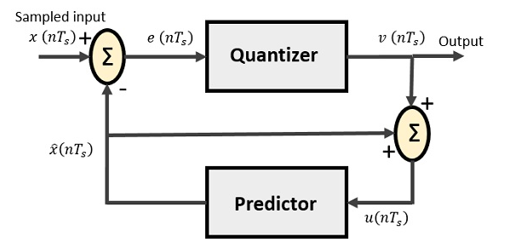
DPCM Transmitter
The DPCM Transmitter consists of Quantizer and Predictor with two summer circuits. Following is the block diagram of DPCM transmitter.

Slide 52
The signals at each point are named as −
x(nTs) is the sampled input
xˆ(nTs) is the predicted sample
e(nTs) is the difference of sampled input and predicted output, often called as prediction error
v(nTs) is the quantized output
u(nTs) is the predictor input which is actually the summer output of the predictor output and the quantizer output
The predictor produces the assumed samples from the previous outputs of the transmitter circuit. The input to this predictor is the quantized versions of the input signal x(nTs).

Slide 53
Quantizer Output is represented as −
v(nTs)=Q[e(nTs)]
=e(nTs)+q(nTs)
Where q (nT_{s}) is the quantization error
Predictor input is the sum of quantizer output and predictor output,
u(nTs)=xˆ(nTs)+v(nTs)
u(nTs)=xˆ(nTs)+e(nTs)+q(nTs)
u(nTs)=x(nTs)+q(nTs)
The same predictor circuit is used in the decoder to reconstruct the original input.

Slide 54
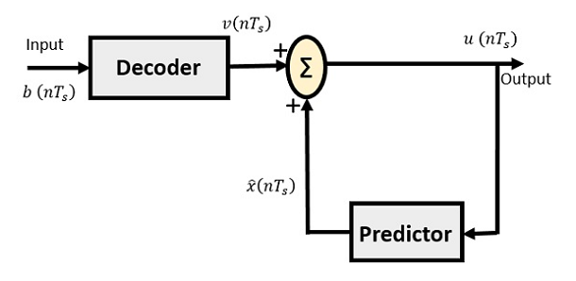
DPCM Receiver
The block diagram of DPCM Receiver consists of a decoder, a predictor, and a summer circuit. Following is the diagram of DPCM Receiver.

Slide 55
The notation of the signals is the same as the previous ones. In the absence of noise, the encoded receiver input will be the same as the encoded transmitter output.
As mentioned before, the predictor assumes a value, based on the previous outputs. The input given to the decoder is processed and that output is summed up with the output of the predictor, to obtain a better output.

Slide 56
Delta and Adaptive Modulation
What is Delta Modulation?
The type of modulation, where the sampling rate is much higher and in which the stepsize after quantization is of smaller value Δ, such a modulation is termed as delta modulation.

Slide 57
Features of Delta Modulation
An over-sampled input is taken to make full use of a signal correlation.
The quantization design is simple.
The input sequence is much higher than Nyquist rate.
The quality is moderate.
The design of the modulator and the demodulator is simple.
The stair-case approximation of output waveform.
The step-size is very small, i.e., Δ (delta).
The bit rate can be decided by the user.
It requires simpler implementation.
Delta Modulation is a simplified form of DPCM technique, also viewed as 1-bit DPCM scheme. As the sampling interval is reduced, the signal correlation will be higher.

Slide 58
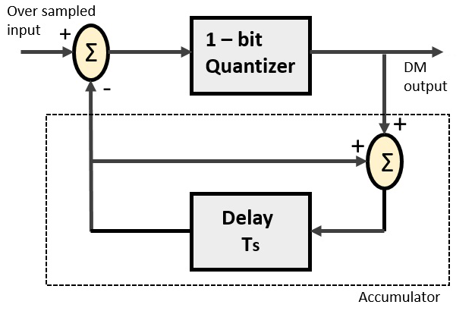
Delta Modulator
The Delta Modulator comprises of a 1-bit quantizer and a delay circuit along with two summer circuits. Following is the block diagram of a delta modulator.

Slide 59
Continued..
A stair-case approximated waveform will be the output of the delta modulator with the step-size as delta (Δ). The output quality of the waveform is moderate.

Slide 60
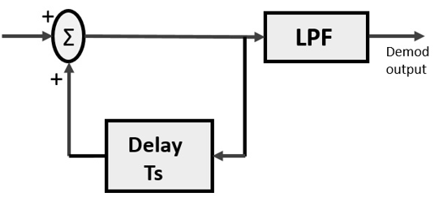
Delta Demodulator
The delta demodulator comprises of a low pass filter, a summer, and a delay circuit. The predictor circuit is eliminated here and hence no assumed input is given to the demodulator.
Following is the block diagram for delta demodulator.

Slide 61
Contd..
Low pass filter is used for many reasons, but the prominent one is noise elimination for out-of-band signals. The step-size error that may occur at the transmitter is called granular noise, which is eliminated here. If there is no noise present, then the modulator output equals the demodulator input.
Advantages of DM over DPCM:
1-bit quantizer
Very easy design of modulator & demodulator
However, there exists some noise in DM and following are the types of noise.
Slope Over load distortion (when Δ is small)
Granular noise (when Δ is large)

Slide 62
Adaptive Delta Modulation
In digital modulation, we come across certain problems in determining the step-size, which influences the quality of the output wave.
The larger step-size is needed in the steep slope of modulating signal and a smaller stepsize is needed where the message has a small slope. As a result, the minute details get missed. Hence, it would be better if we can control the adjustment of step-size, according to our requirement in order to obtain the sampling in a desired fashion. This is the concept of Adaptive Delta Modulation (ADM).

Slide 63
Frequency Hopped Spread Spectrum
This is frequency hopping technique, where the users are made to change the frequencies of usage, from one to another in a specified time interval, hence called as frequency hopping. For example, a frequency was allotted to sender 1 for a particular period of time. Now, after a while, sender 1 hops to the other frequency and sender 2 uses the first frequency, which was previously used by sender 1. This is called as frequency reuse.
The frequencies of the data are hopped from one to another in order to provide a secure transmission. The amount of time spent on each frequency hop is called as Dwell time.

Slide 64
Companding
Companding refers to a technique for compressing and then expanding (or decompressing) an analog or digital signal. It is a combination of the words "compressing" and "expanding." This twin-sequential process is non-linear overall but linear over short periods of time. Data is compressed before being transmitted.

Slide 65
Unit-3 Digital Modulation Techniques
Basic block diagram and principle of working of the following:
-Amplitude shift keying (ASK): Interrupted continuous wave (ICW), two tone modulation
-Frequency Shift keying (FSK)
-Phase shift keying (PSK), Quadrature Phase Shift Keying(QPSK)

Slide 66
Amplitude Shift Keying
Amplitude Shift Keying is a type of Amplitude Modulation which represents the binary data in the form of variations in the amplitude of a signal.
Any modulated signal has a high frequency carrier. The binary signal when ASK modulated, gives a zero value for Low input while it gives the carrier output for High input.

Slide 67
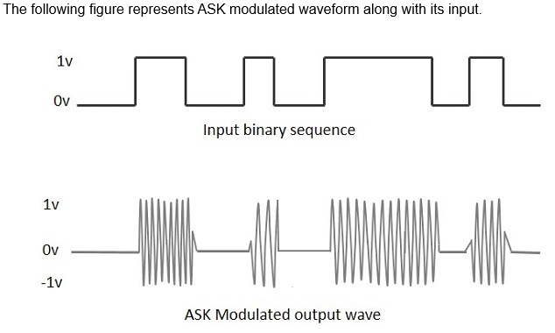

Slide 68
ASK Modulator

Slide 69
Contd..
The carrier generator, sends a continuous high-frequency carrier. The binary sequence from the message signal makes the unipolar input to be either High or Low. The high signal closes the switch, allowing a carrier wave. Hence, the output will be the carrier signal at high input. When there is low input, the switch opens, allowing no voltage to appear. Hence, the output will be low.
The band-limiting filter, shapes the pulse depending upon the amplitude and phase characteristics of the band-limiting filter or the pulse-shaping filter.

Slide 70
ASK Demodulator
There are two types of ASK Demodulation techniques. They are −
Asynchronous ASK Demodulation/detection
Synchronous ASK Demodulation/detection
The clock frequency at the transmitter when matches with the clock frequency at the receiver, it is known as a Synchronous method, as the frequency gets synchronized. Otherwise, it is known as Asynchronous.

Slide 71
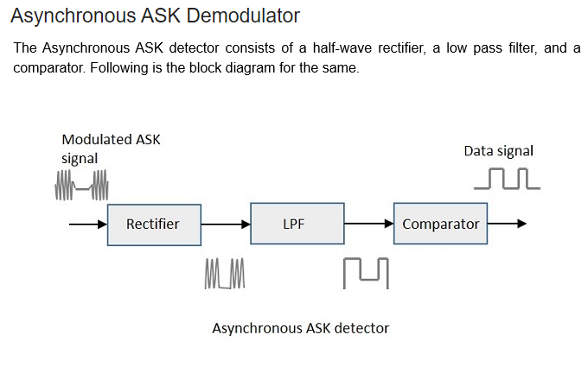

Slide 72
Contd..
The modulated ASK signal is given to the half-wave rectifier, which delivers a positive half output. The low pass filter suppresses the higher frequencies and gives an envelope detected output from which the comparator delivers a digital output.

Slide 73
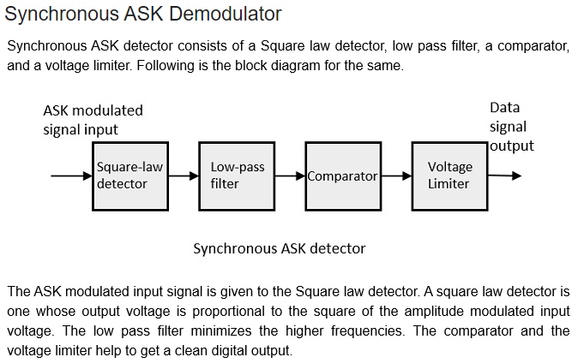

Slide 74
Frequency Shift Keying
Frequency Shift Keying FSK is the digital modulation technique in which the frequency of the carrier signal varies according to the digital signal changes. FSK is a scheme of frequency modulation.
The output of a FSK modulated wave is high in frequency for a binary High input and is low in frequency for a binary Low input. The binary 1s and 0s are called Mark and Space frequencies.

Slide 76
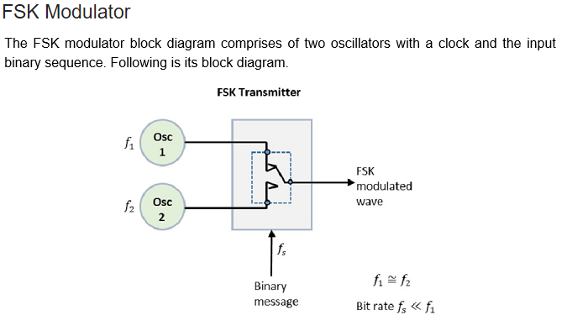

Slide 77
Contd..
The two oscillators, producing a higher and a lower frequency signals, are connected to a switch along with an internal clock. To avoid the abrupt phase discontinuities of the output waveform during the transmission of the message, a clock is applied to both the oscillators, internally. The binary input sequence is applied to the transmitter so as to choose the frequencies according to the binary input.

Slide 78
FSK Demodulator
There are different methods for demodulating a FSK wave. The main methods of FSK detection are asynchronous detector and synchronous detector. The synchronous detector is a coherent one, while asynchronous detector is a non-coherent one.

Slide 79
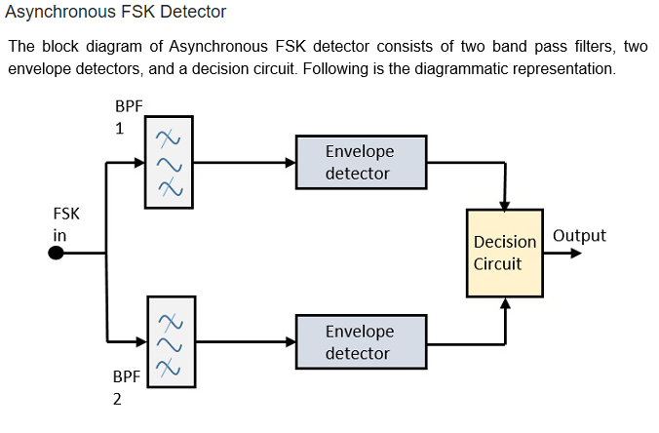

Slide 80
Contd..
The FSK signal is passed through the two Band Pass Filters BPFsBPFs, tuned to Space and Mark frequencies. The output from these two BPFs look like ASK signal, which is given to the envelope detector. The signal in each envelope detector is modulated asynchronously.
The decision circuit chooses which output is more likely and selects it from any one of the envelope detectors. It also re-shapes the waveform to a rectangular one.

Slide 81
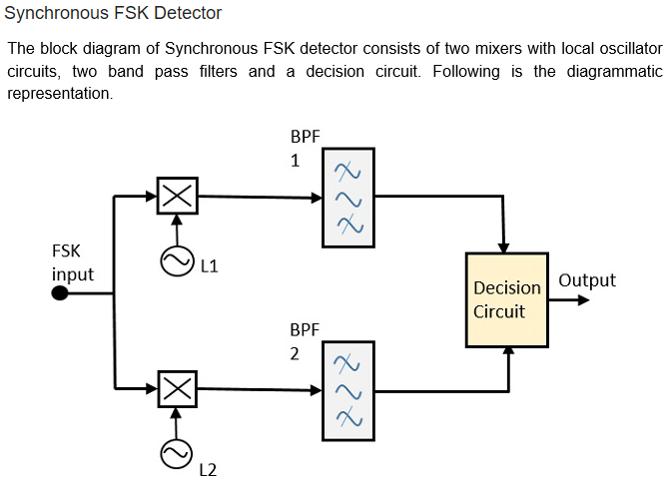

Slide 82
Contd..
The FSK signal input is given to the two mixers with local oscillator circuits. These two are connected to two band pass filters. These combinations act as demodulators and the decision circuit chooses which output is more likely and selects it from any one of the detectors. The two signals have a minimum frequency separation.
For both of the demodulators, the bandwidth of each of them depends on their bit rate. This synchronous demodulator is a bit complex than asynchronous type demodulators.

Slide 83
Phase Shift Keying
Phase Shift Keying PSKPSK is the digital modulation technique in which the phase of the carrier signal is changed by varying the sine and cosine inputs at a particular time. PSK technique is widely used for wireless LANs, bio-metric, contactless operations, along with RFID and Bluetooth communications.

Slide 84
PSK is of two types, depending upon the phases the signal gets shifted. They are −
Binary Phase Shift Keying BPSK
This is also called as 2-phase PSK or Phase Reversal Keying. In this technique, the sine wave carrier takes two phase reversals such as 0° and 180°.
BPSK is basically a Double Side Band Suppressed Carrier DSBSC modulation scheme, for message being the digital information.
Quadrature Phase Shift Keying QPSK
This is the phase shift keying technique, in which the sine wave carrier takes four phase reversals such as 0°, 90°, 180°, and 270°.
If this kind of techniques are further extended, PSK can be done by eight or sixteen values also, depending upon the requirement.

Slide 85
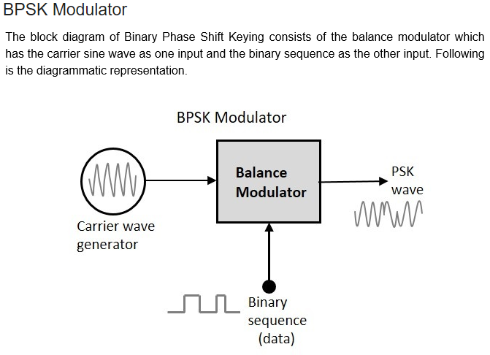

Slide 86
Contd..
The modulation of BPSK is done using a balance modulator, which multiplies the two signals applied at the input. For a zero binary input, the phase will be 0° and for a high input, the phase reversal is of 180°.

Slide 87
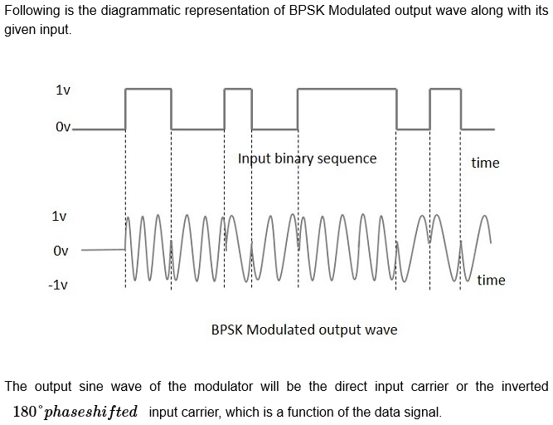

Slide 88
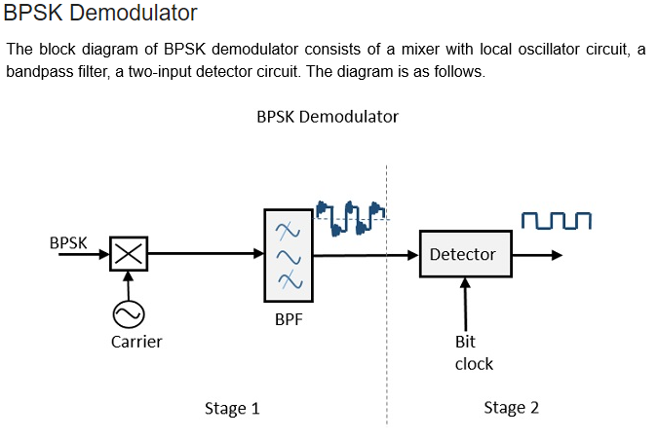

Slide 89
Contd..
By recovering the band-limited message signal, with the help of the mixer circuit and the band pass filter, the first stage of demodulation gets completed. The base band signal which is band limited is obtained and this signal is used to regenerate the binary message bit stream.
In the next stage of demodulation, the bit clock rate is needed at the detector circuit to produce the original binary message signal. If the bit rate is a sub-multiple of the carrier frequency, then the bit clock regeneration is simplified. To make the circuit easily understandable, a decision-making circuit may also be inserted at the 2nd stage of detection.

Slide 90
Quadrature Phase Shift Keying
The Quadrature Phase Shift Keying QPSK is a variation of BPSK, and it is also a Double Side Band Suppressed Carrier DSBSCDSBSC modulation scheme, which sends two bits of digital information at a time, called as bigits.
Instead of the conversion of digital bits into a series of digital stream, it converts them into bit pairs. This decreases the data bit rate to half, which allows space for the other users.

Slide 91
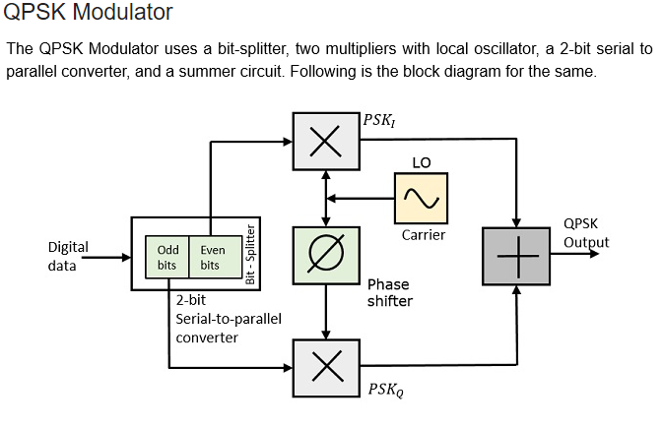

Slide 92
Contd..
At the modulator’s input, the message signal’s even bits (i.e., 2nd bit, 4th bit, 6th bit, etc.) and odd bits (i.e., 1st bit, 3rd bit, 5th bit, etc.) are separated by the bits splitter and are multiplied with the same carrier to generate odd BPSK (called as PSK_{I}) and even BPSK (called as PSK_{Q}). The PSK_{Q} signal is anyhow phase shifted by 90° before being modulated.

Slide 94
